Slide 1
Java Revisited
CSC 212: Data Structures

Slide 2
Objective
Object Oriented Programming (OOP): What, Why, How
Analyzing and Designing OO Programs (Objects & Classes)
Java Syntax, Java Program Skeleton
Analyzing and Designing a Program
Preparing Classes.

Slide 3
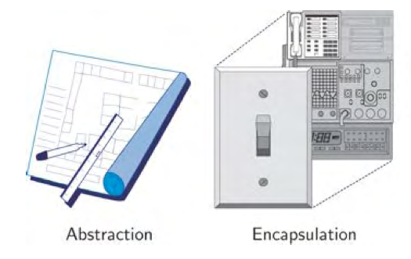
Object-Oriented Design Principles
Abstraction
To distill a complicated system down to its most fundamental parts and describe these parts in a simple, precise language.
Encapsulation
Different components of a software system should not reveal the internal details of their respective implementations.
Notes:
We can understand and use a data type without knowing all of its implementation details
 Neither how the data is represented nor how the operations are implemented
 We just need to know the interface (or method headers) – how to “communicate” with the object
 Compare to functional abstraction with methods

Slide 4
Object-Oriented Design Principles
Inheritance
Properties of a data type can be passed down to a subtype. We can build new types from old ones
We can build class hierarchies with many levels of inheritance
Allows the design of general classes that can be specialized to more particular classes, with the specialized classes reusing the code from the general class.

Slide 5
Object-Oriented Design Principles
Polymorphism
Polymorphism is the capability of a method to do different things based on the object that it is acting upon.
Following concepts demonstrate different types of polymorphism in java.
Method Overloading
Method Overriding

Slide 6
Object-Oriented Design Principles
Overloading :
Allows the same method name to have multiple meanings or uses.
Overloading of methods allows to use the same name to perform different actions depending on parameters.
Overloaded methods are differentiated only on the number, type and order of parameters, not on the return type of the method.
Overriding:
Declaring a method in subclass which is already present in parent class is known as method overriding.

Slide 7
Inheritance
Person
Employee
Teacher
Payment
Contract

Slide 8
Polymorphism
The derived classes override the definitions to provide unique behavior for each specific type of Employee
Dynamic binding :
Which method to call?
Binding occurs at run time, based on the type of object.
Employee
Payment
Contract
calcSalary ()
calcSalary ()

Slide 9
Designing Object Oriented
It’s a process of planning a computer program where objects will interact with each other to solve specific problems.
Example :
A hotel contains a number of Residential rooms, Meeting rooms, Wedding halls where the customer can reserve any of them by choosing type of room and specify date and time. You are required to design reservation system for Hotel. where it can offer the available rooms or halls and allows the customer to reserve one of them.
Notes:
example /problem

Slide 10
Designing Object Oriented
Objects = nouns Functions to be encapsulated
customer
reservation
room
regular
meeting
hall
Notes:
example /problem

Slide 11
Argument passing
All arguments in Java are passed by value.
The method creates a copy of the argument, and manipulate the copy (not the argument itself).
It is therefore impossible to change the argument from within the method.
This means that it is impossible to change the value of an argument of a primitive type (int, double, char, …).
Reference variables cannot be changed inside methods as well, but their content can be changed.

Slide 12
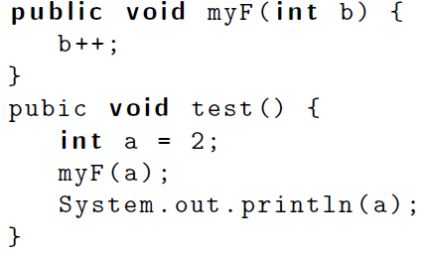
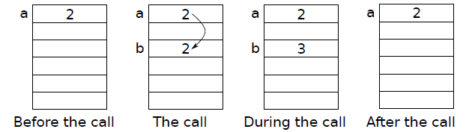
Argument passing: primitive type variables

Slide 13
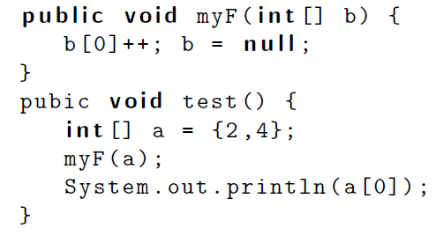
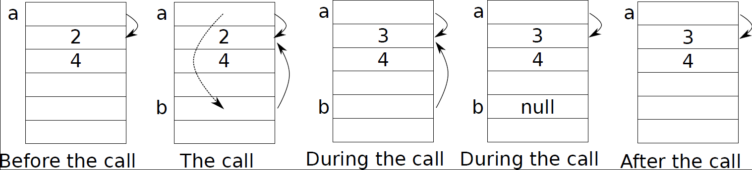
Argument passing: reference variables

Slide 14
Object class
The Object class is the parent class of all the classes in java by default. In other words, it is the topmost class of java.
The Object class is beneficial if you want to refer any object whose type you don't know.

Slide 15
Wrappers
The Java primitive types are NOT classes, and thus cannot be used as easy as objects
If I make an array of Object or any other class, primitive types cannot be stored in it.
Wrapper classes allow to get around this problem
Wrappers are classes that “wrap” objects around primitive values, thus making them compatible with other Java classes
We cannot store an int in an array of Object, but we can store an Integer

Slide 16
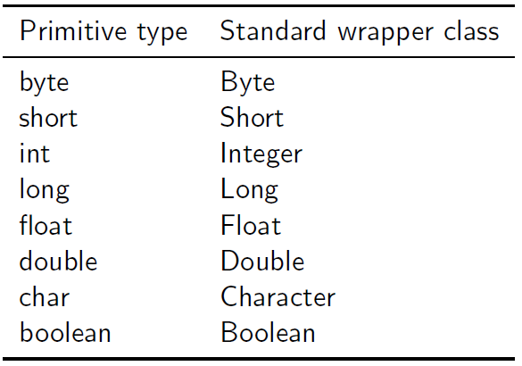
Java wrappers
Java offers a set of standard wrapper classes for all primitive data types.
Integer i, j, k;
i = new Integer(20); // or i=20; is also correct
j = new Integer(40);
Java wrappers are immutable, which means that their content cannot be changed once created. Hence they cannot be used for parameter passing.

Slide 17
Java wrappers
The wrapper classes also provide extra useful functionality for these types
Ex: Integer.parseInt(String s) is a static method that enables us to convert from a String into an int
Ex: Character.isLetter(char c) is a static method that tests if a letter is a character or not
Integer
int
Double
double

Slide 18
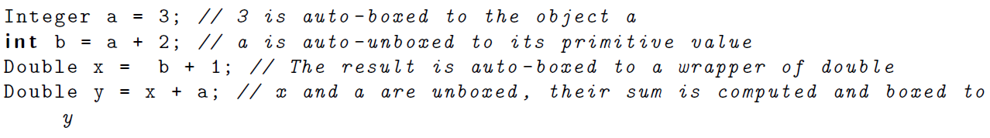
Java wrappers
J2SE 5.0 introduced the feature of auto-boxing and auto-unboxing of standard primitive wrappers. This means that primitive types are automatically converted to their wrappers, and vice-versa, as necessary.

Slide 19
Wrappers
Since all arguments are passed by value in Java, how can we solve problems like the following:
Example: we want to write a method checkModify that takes as input an integer parameter n and performs the following:
If n is odd, the method returns false.
If n is even, the method returns true and changes n to n/2.
Since the return statement returns a boolean, we cannot return the value n/2.
One possible solution is to use wrappers (not Java wrappers).

Slide 20
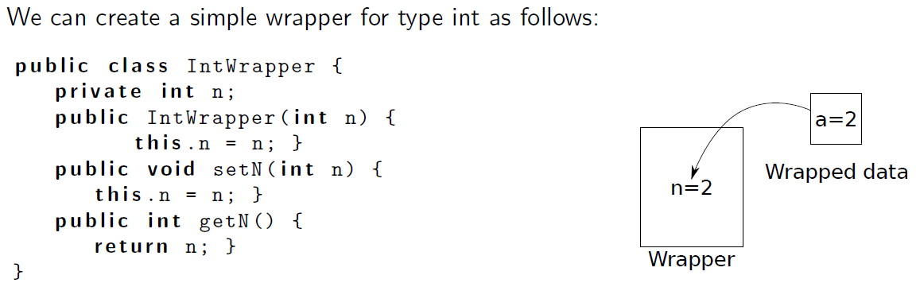
Creation and use of a wrapper
A wrapper is a class that is used to store an object of a certain type and hence allows modifying the object.

Slide 21
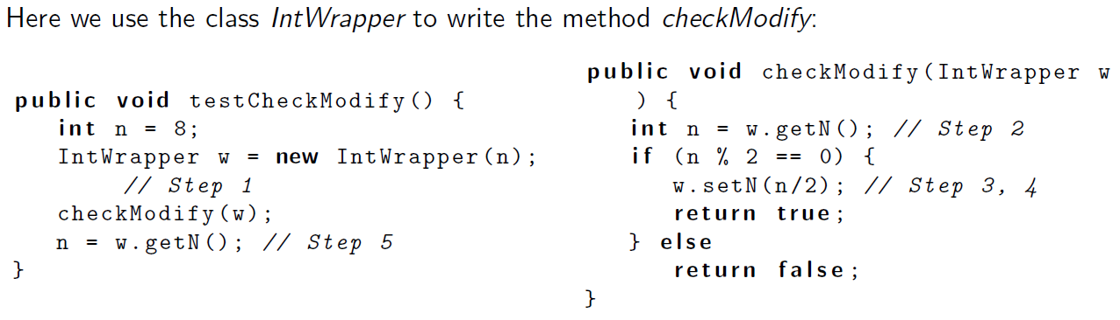
Creation and use of a wrapper
Wrappers are generally used for two purposes:
To store primitive types in classes that require objects.
For passing parameters that can be changed inside a method. This use involves usually 5 steps:
Calling method: create a wrapper object and put the data inside it, then pass it as a parameter.
Called method: take the data from the wrapper. (use getters)
Called method: modify the data.
Called method: update the data of the wrapper. (use setters)
Calling method: take the updated value from the wrapper.

